Slide 1



Community Pot Presentation
27th November 2019
Applecross Forum

Slide 2


ACC Proposal:
Match Fund the Community Pot with other funds to build affordable housing for community benefit.
Rural Housing Fund
Community Pot
Scottish Land Fund
Other funders..

Slide 3
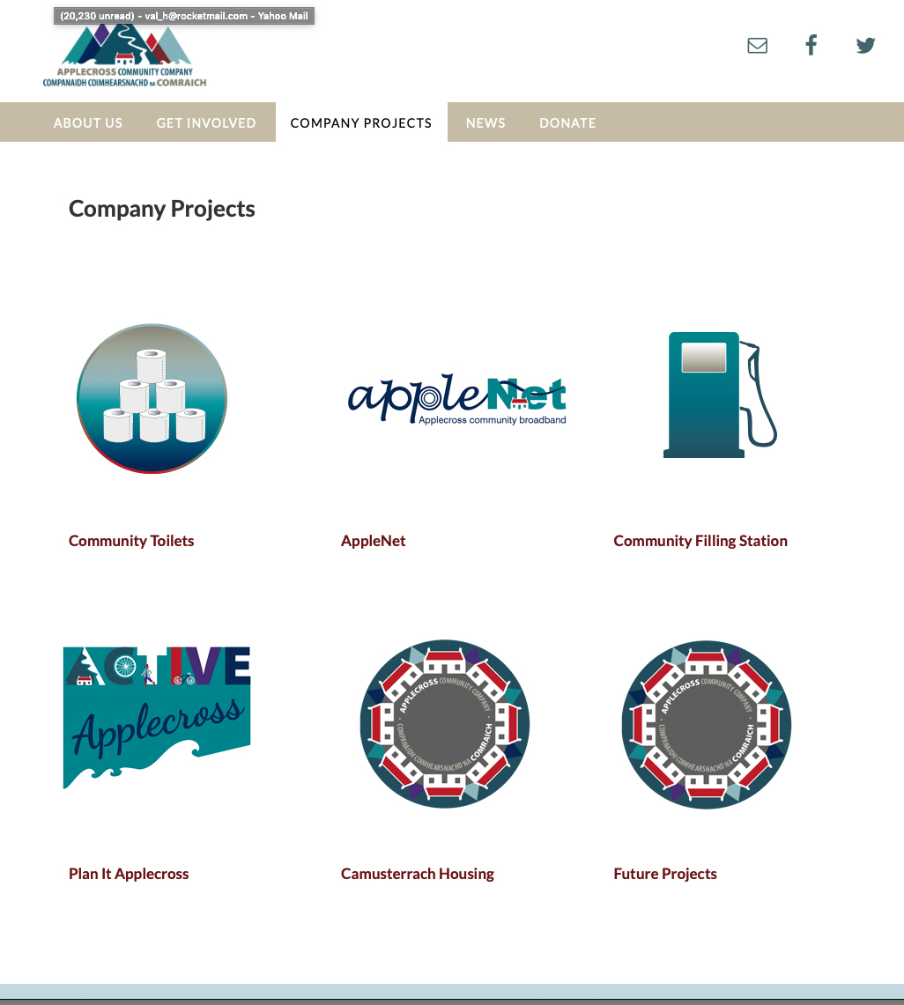

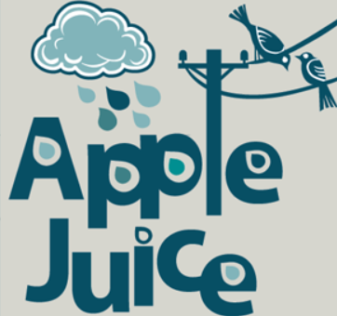
Why the Community Company?
Constituted body
  registered Charity and Company Limited by Guarantee
Community controlled
  Anyone can join and ACC reports to the community
Experienced and well established
  Developed Filling station, toilets, AppleNet and AppleJuice...
  Dedicated directors and employed LDOs
Clear vision
  5 year Action Plan developed

Slide 4

But do we really need more houses?
Yes! The need has been well documented. ACC wish to investigate a range of housing options:
Affordable Housing
Self Build Plots
“Rent to Buy” housing
Evidence of Housing Need:
2019 Plan It Applecross
2018 ACC community survey
2017 Shared Community Vision
2016 HSCHT Housing Needs Survey
2015 Highland Council Housing
Needs Survey
We want to:
Provide improved housing options in a phased approach.
Encourage our community to grow and prosper
Sustain a viable population to maintain access to services (e.g. School, shop, GP)

Slide 5
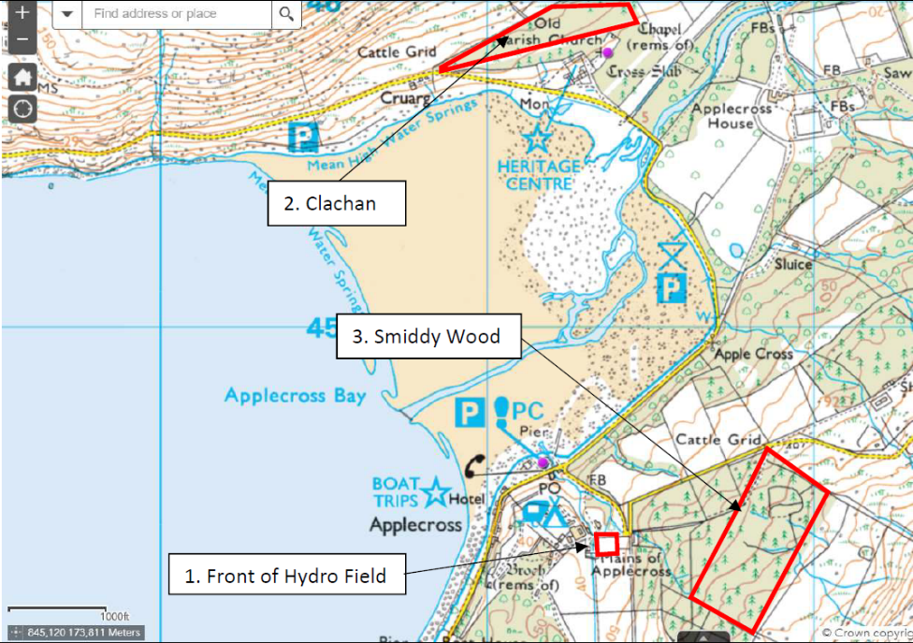
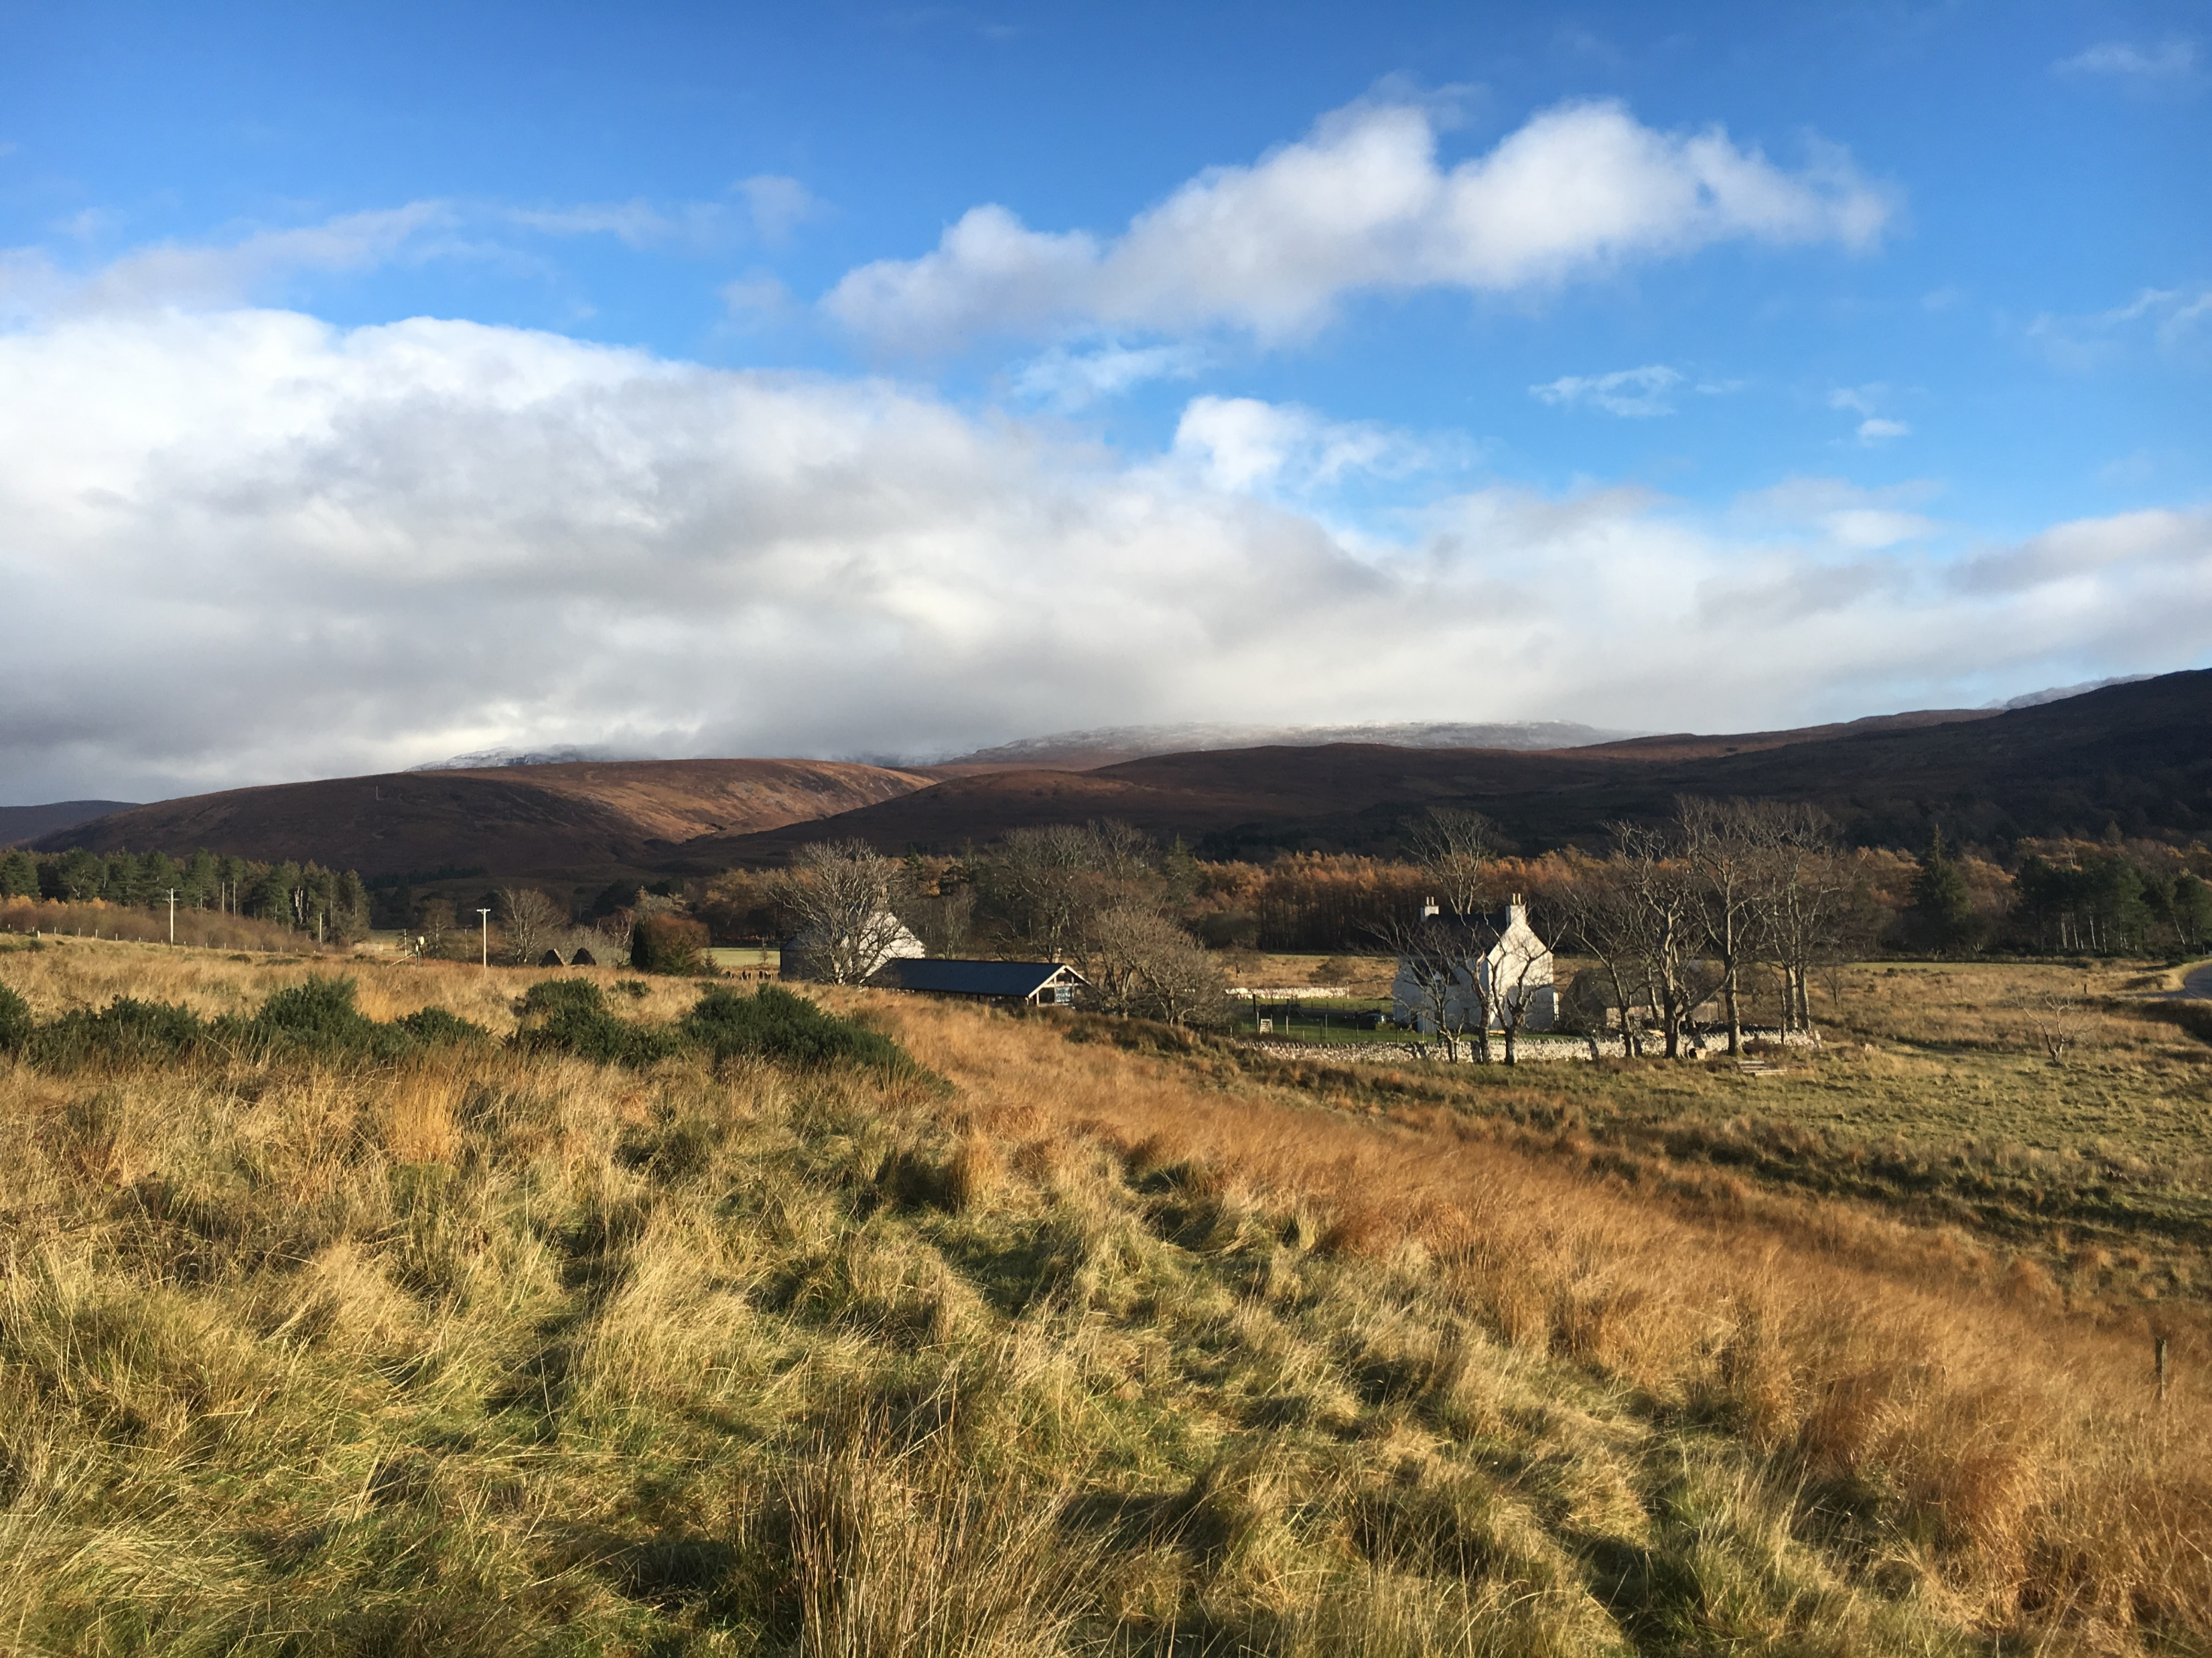
Project Ready!
3 possible sites identified
  Plan It Applecross community consultation identified three sites
  Applecross Trust agreement in principle for land transfer
Feasibility Study underway
  Nov – Mar 2020
  Fully funded by Scottish Land Fund and Rural Housing Fund (£31,468)
  Community presentation of results Feb/March 2020.
Next steps
  Community approval on land purchase
  Apply for Scottish Land Fund for 95% of land purchase
  Apply for funds for housing development – RHF, SSE…

Slide 6

Match Funding – how does it work?
Match funding is when an organisation agrees to match (or partially match) money pledged by a funder(s) to a charity or cause. It is a simple way to maximise the fundraising efforts.
Funders LOVE match funding
  Shows commitment from the community
  Increases likelihood of project success
  Funders like to joint fund
Key funders
  Rural Housing Fund – typically fund 60% of housing projects
  Scottish Land Fund – 95% funding for land purchase
  SSE Sustainable Development Fund –MF required

Slide 7
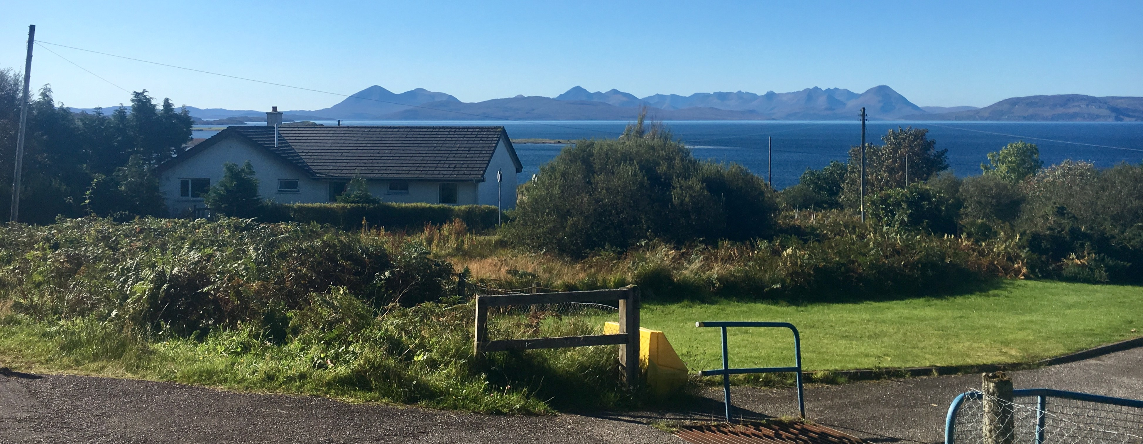
Match Funding –
example
Camusterrach Housing
  SSE Sustainable Development Grant £ 56,000 13%
  Rural Housing Fund £290,000 66%
  ACC Funds/Loan £ 94,000 21% (Match Funding)
  Total £440,000
£170,000 Community Pot
Match funding the community pot would allow us to maximise the impact that this money could have on the provision of affordable housing in Applecross:
Funders £345,000 66%
  Community Pot £170,000 33% (Match Funding)
  Total £515,000

Slide 8
Summary
Match funding the community pot would allow us to maximise the impact that this money could have on the provision of affordable housing in Applecross

